Slide 1



Journey PPT
28 Aug 2023 – 1 Sep 2023
Journey PPT
Name – Utkarsh Dwivedi
Batch - 8

Slide 2
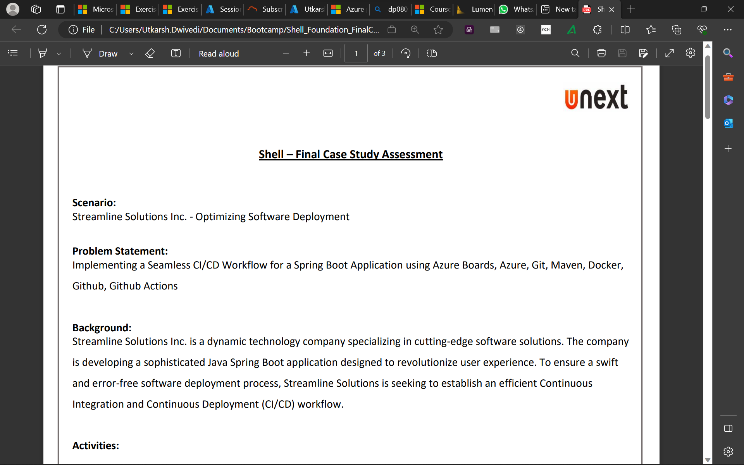
Day – 1 Case Study

Slide 3
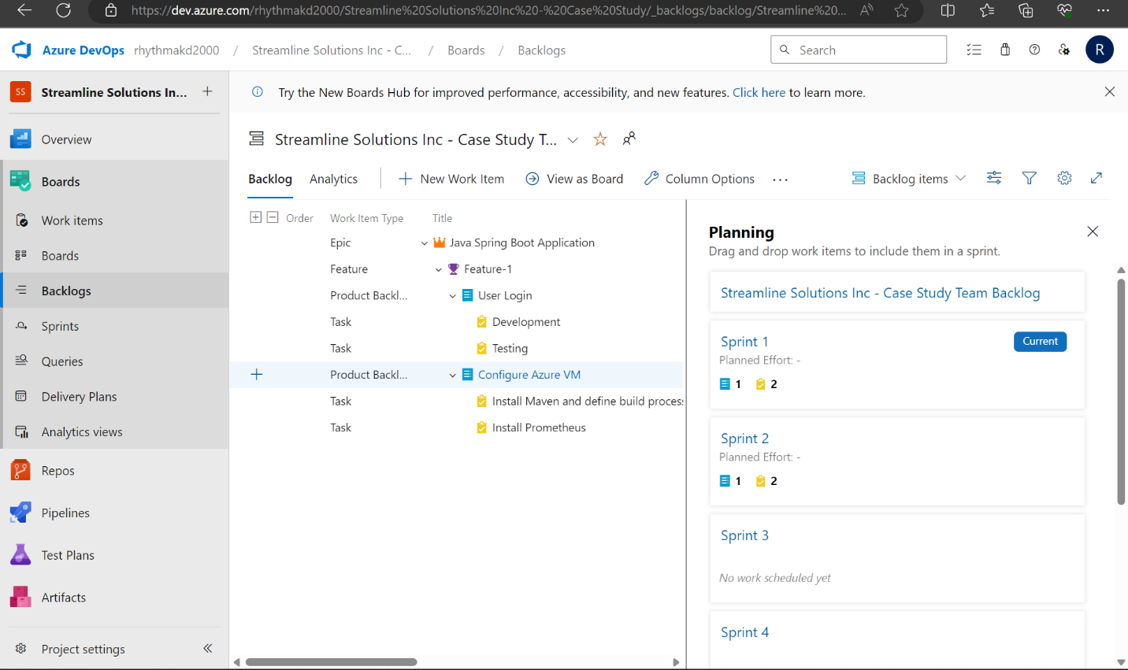

Slide 4
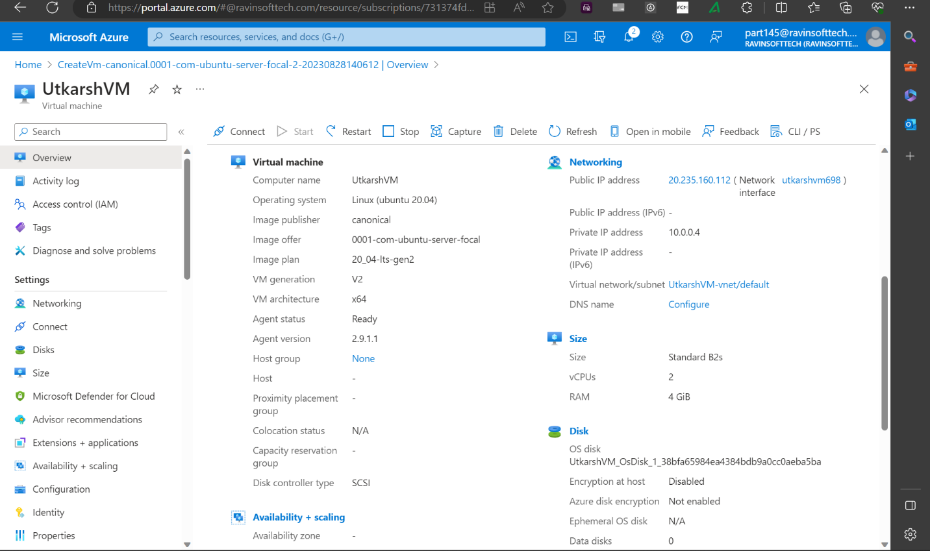

Slide 5
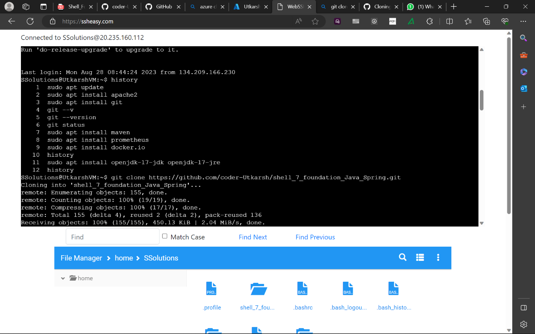

Slide 6
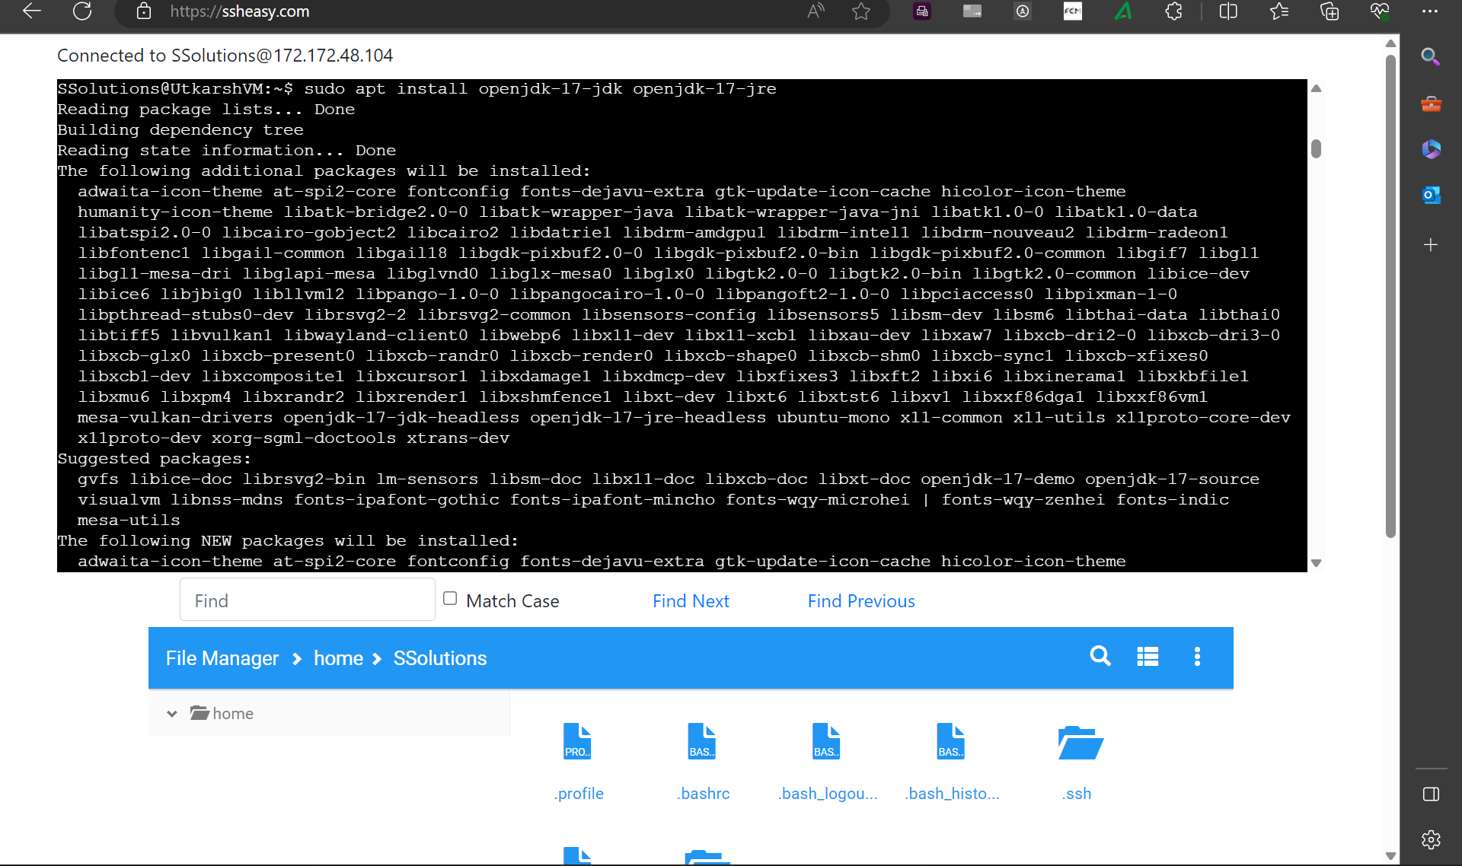

Slide 7
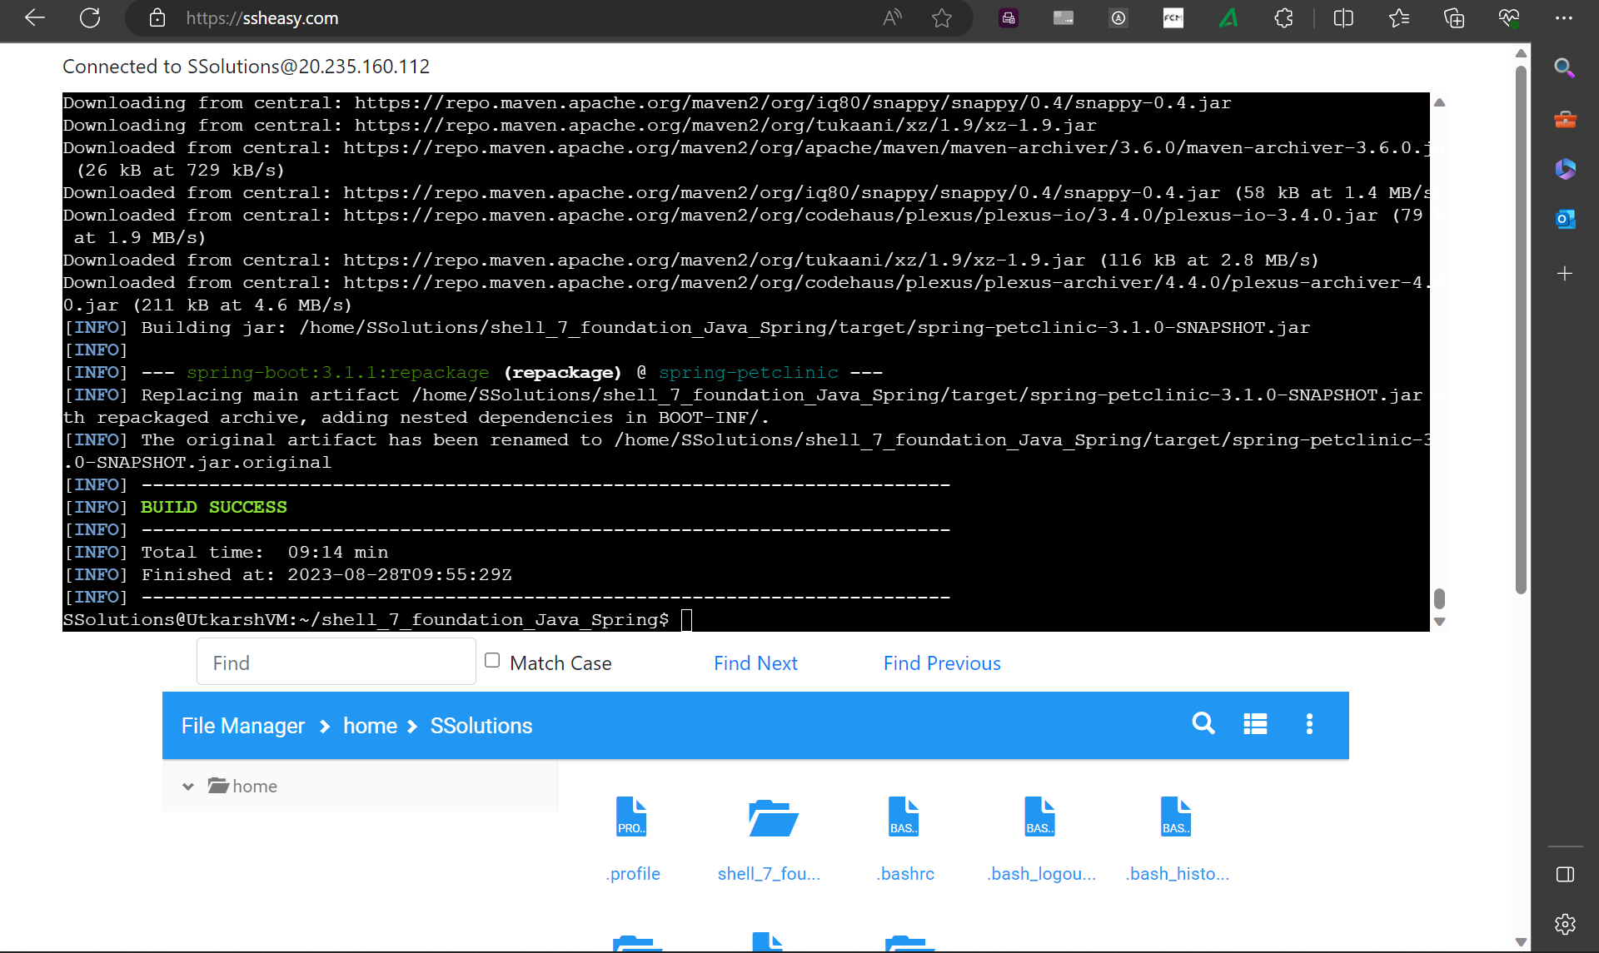

Slide 8
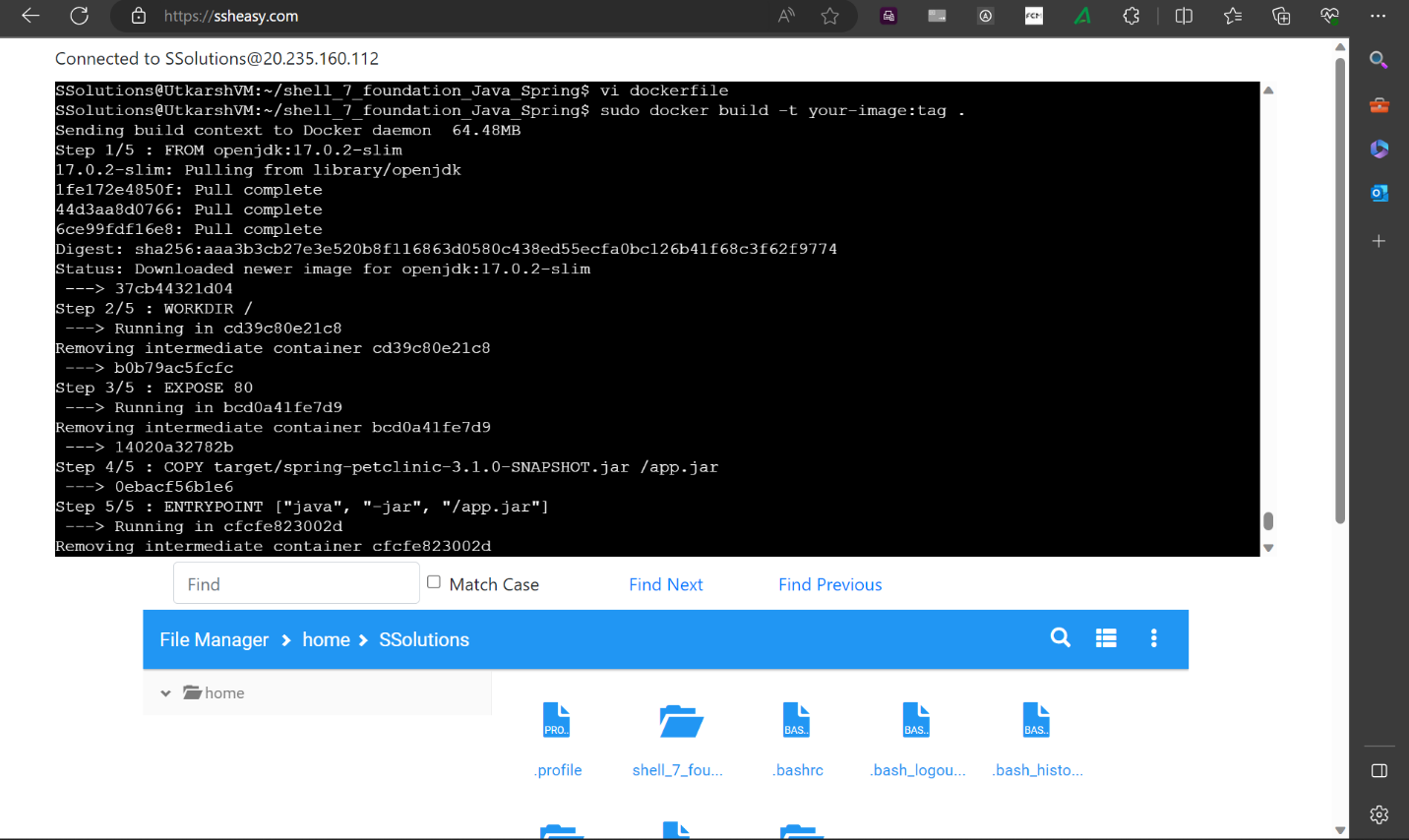

Slide 9
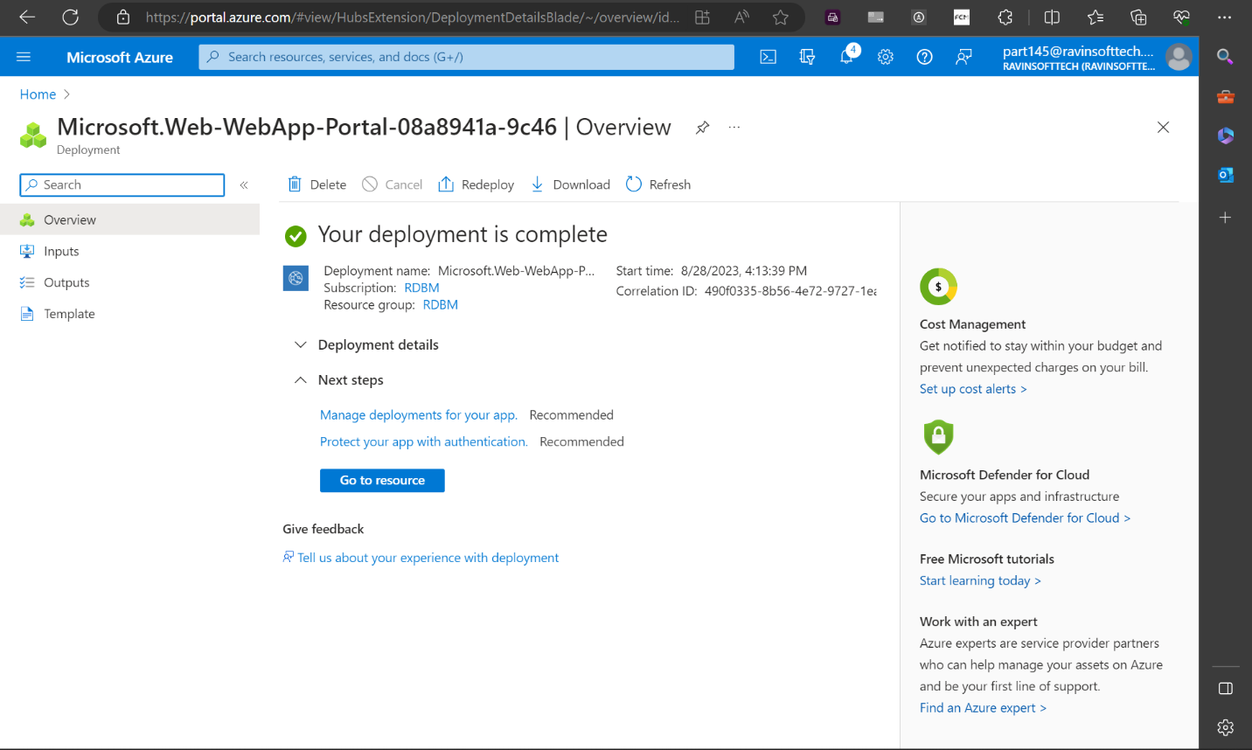

Slide 10
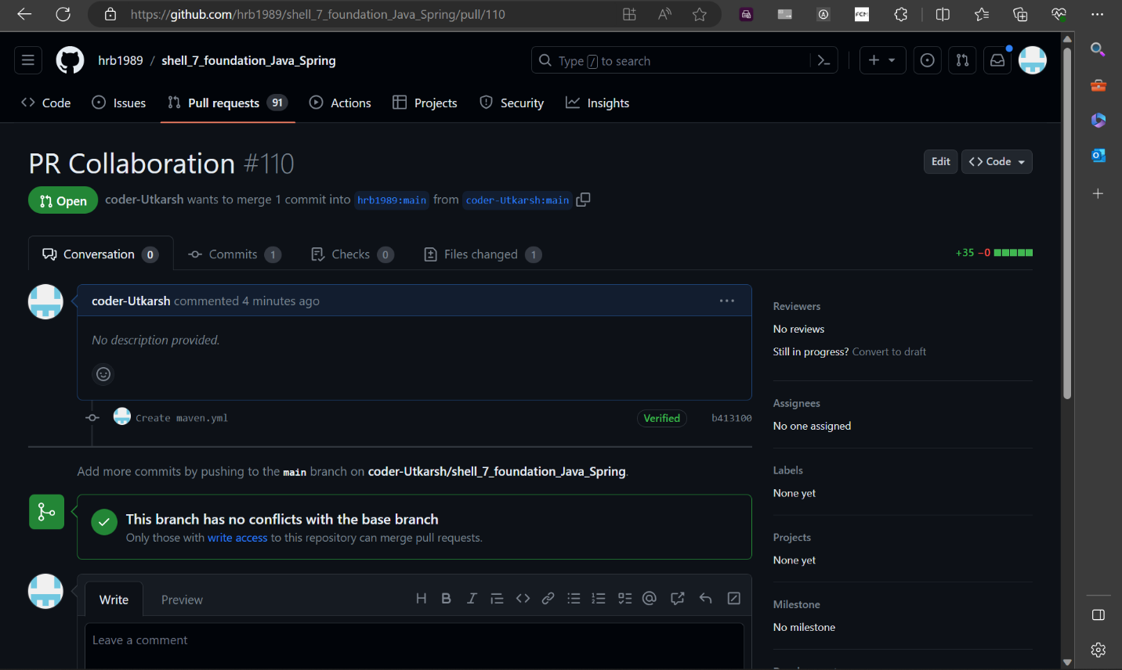

Slide 11
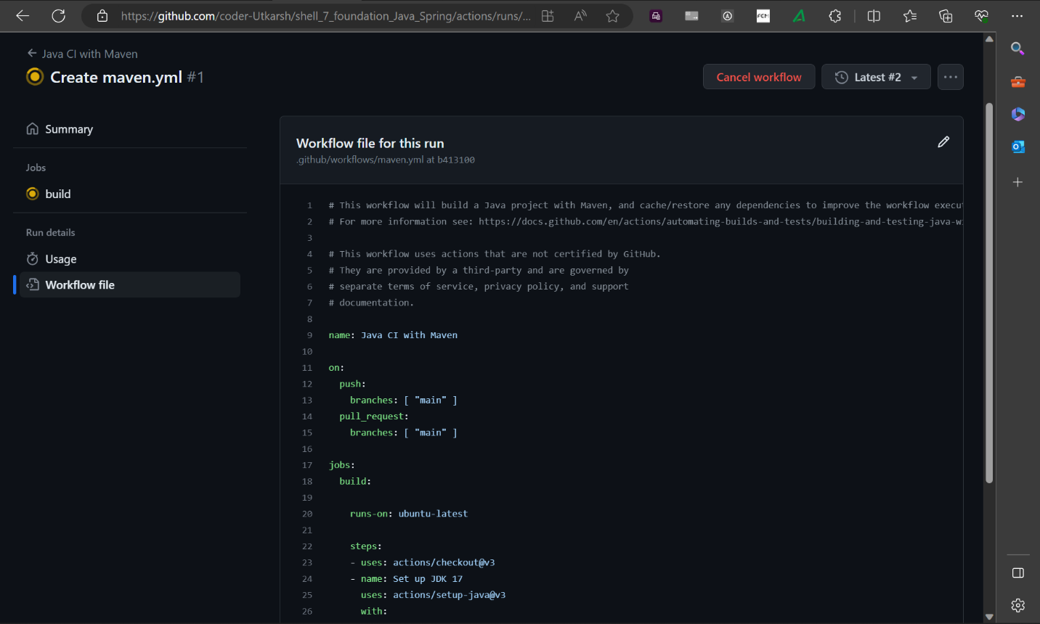

Slide 13
Day – 2 DBMS
Basics of DBMS
ER models
Normalization
Schema:
Star
Snowflake
Big Data Overview
Structured, Unstructured, Semi-Structured data

Slide 14
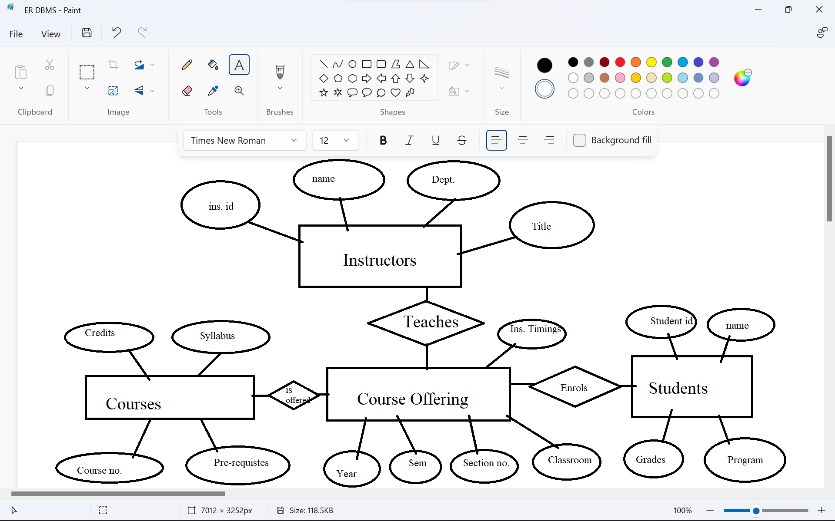
Day – 2 DBMS
Basics of DBMS
ER models
Normalization
Schema:
Star
Snowflake
Big Data Overview
Structured, Unstructured, Semi-Structured data

Slide 15
Day – 3 Azure Fundamentals
CRUD operations
Basics of Azure
Azure Datalakes
Azure Cosmos DB
Data warehouse
Datalake Architecture
Big Data Analytics

Slide 16
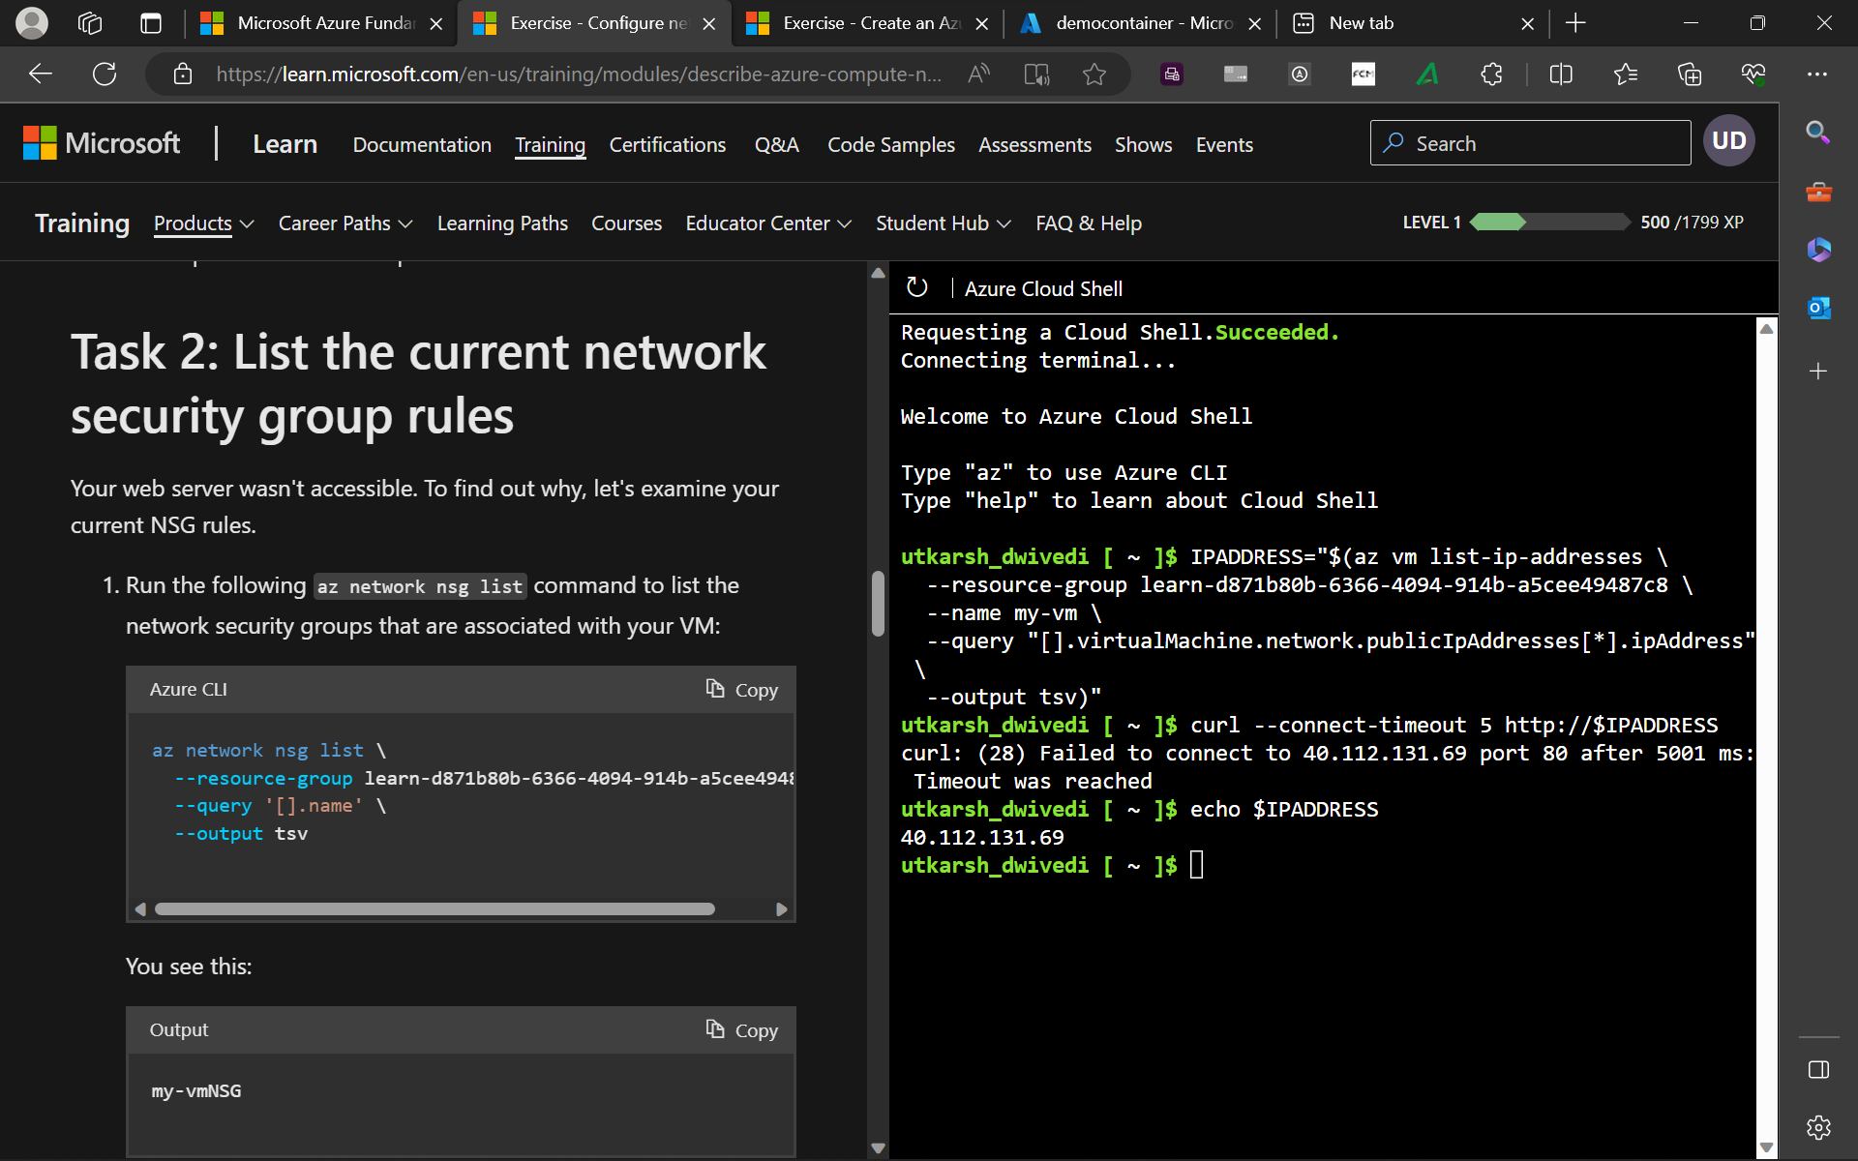

Slide 17
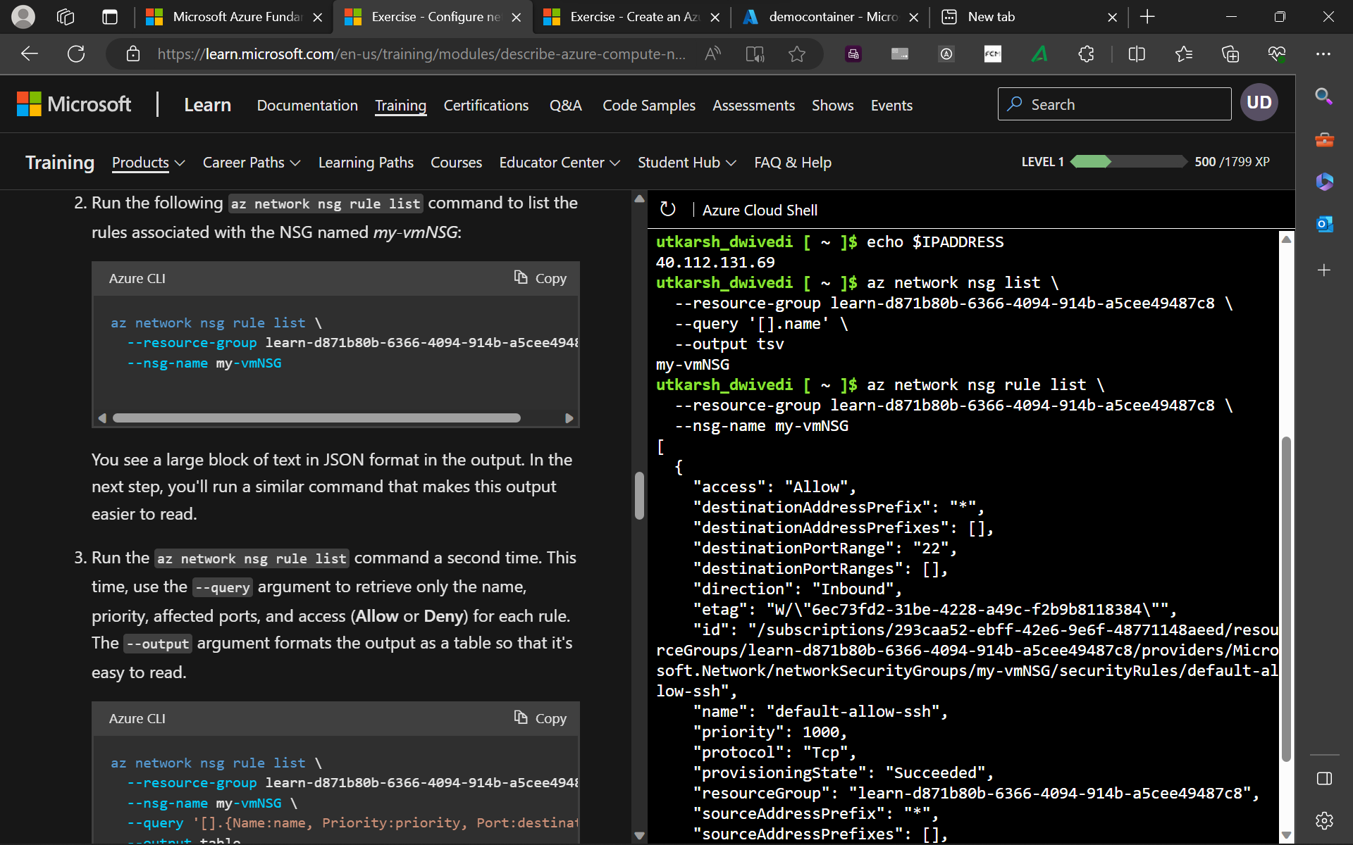

Slide 18
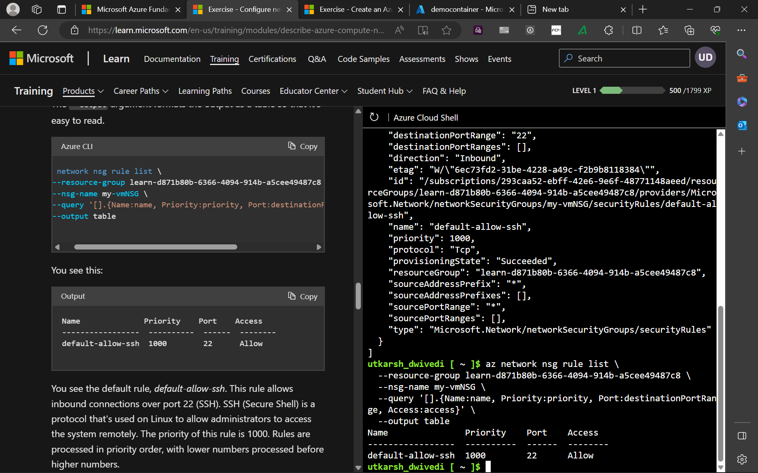

Slide 19
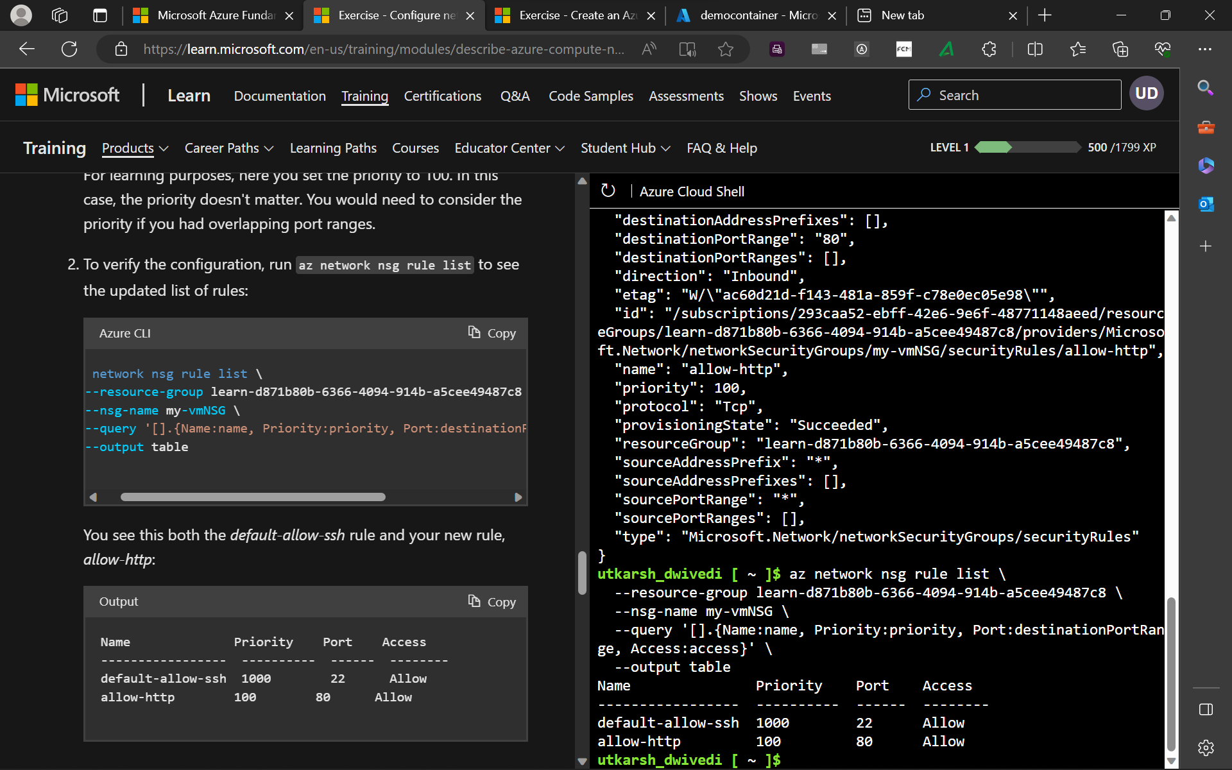

Slide 21
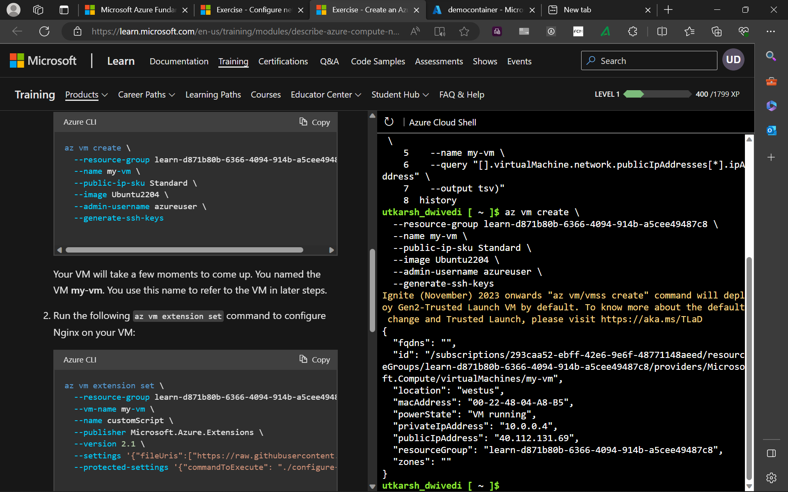

Slide 22
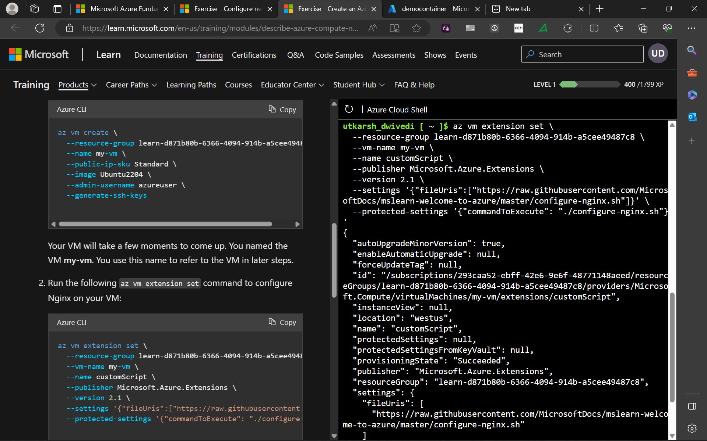

Slide 23
Day – 4 Azure SQL
CRUD operations
Basics of Azure
Azure Datalakes
Azure Cosmos DB
Data warehouse
Datalake Architecture
Big Data Analytics

Slide 24
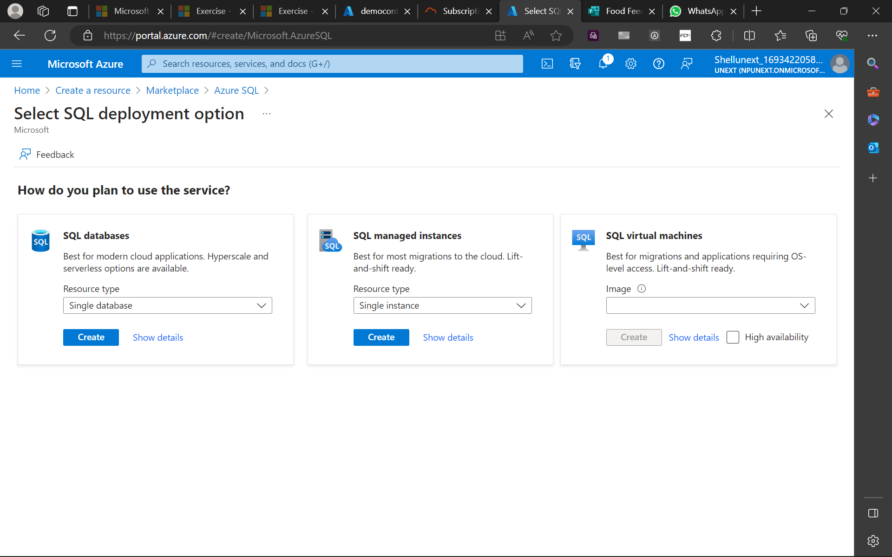

Slide 25
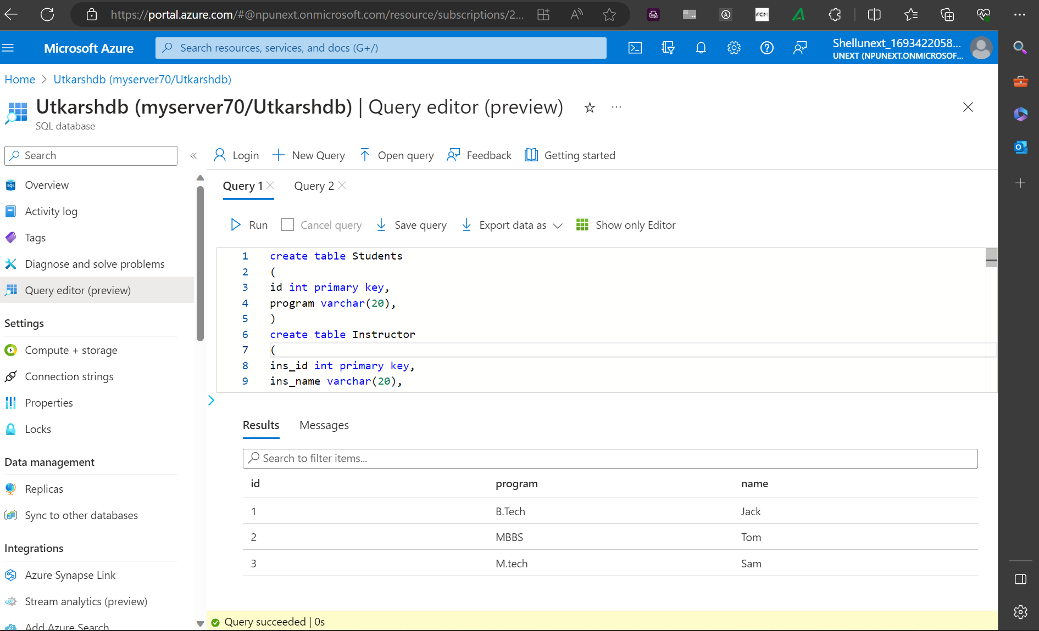

Slide 26
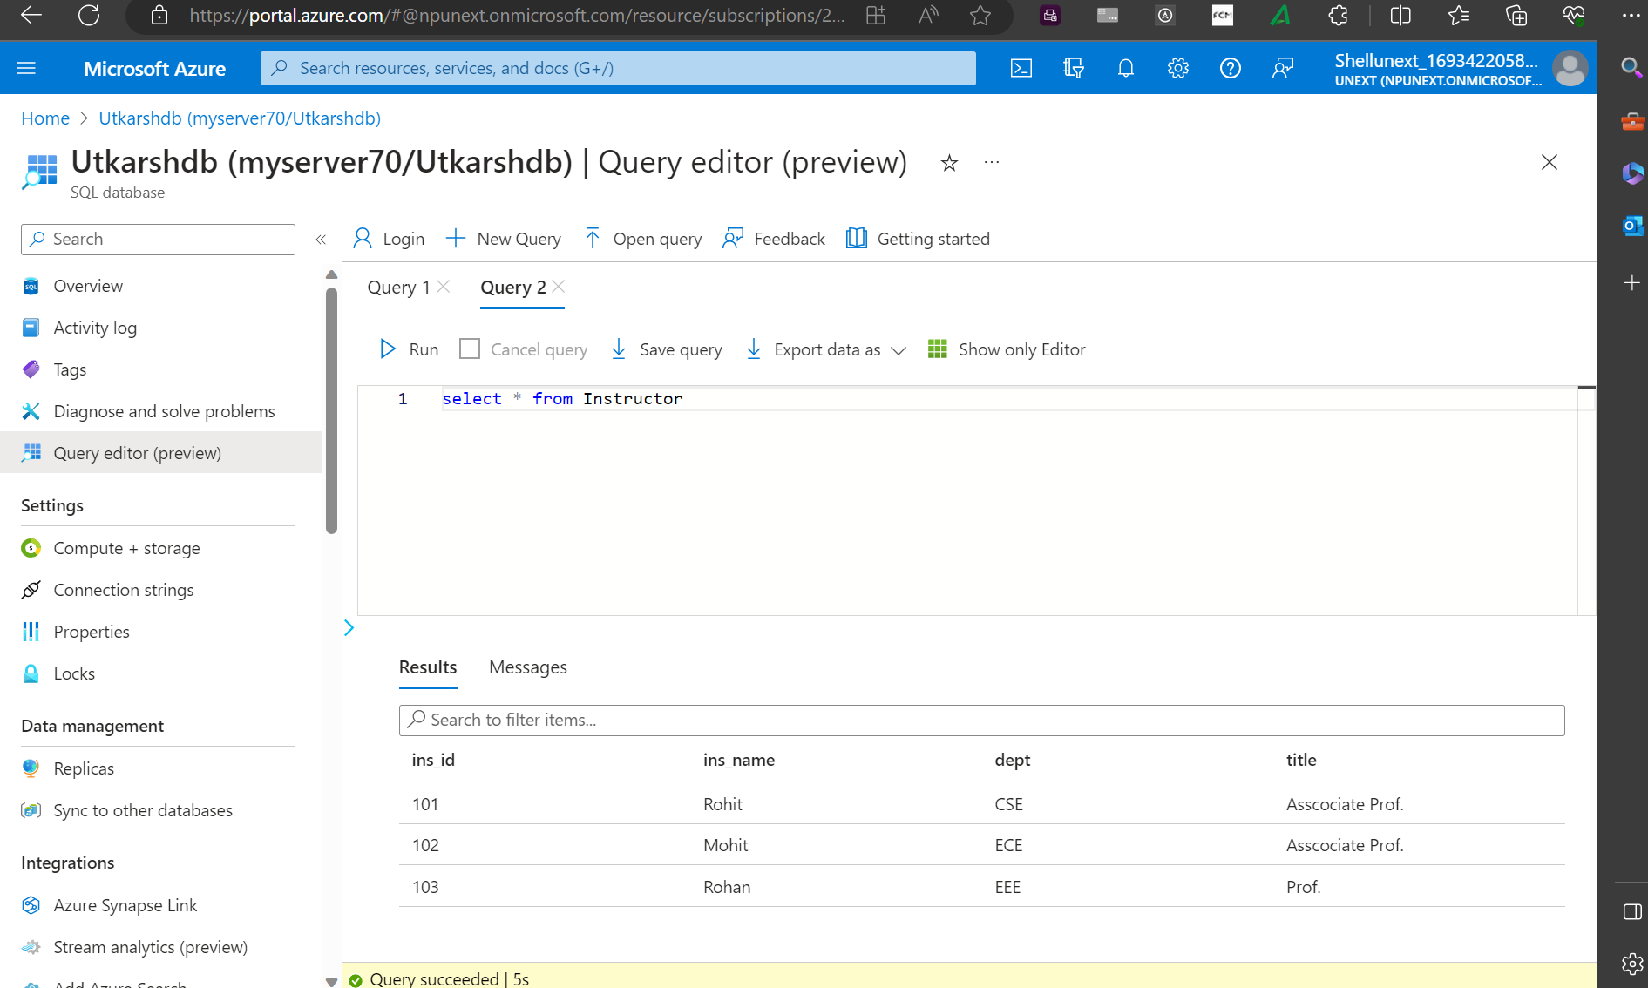

Slide 27
Day – 5 Azure SQL continued..
Joins
Inner Joins
Outer Joins
Self-Joins
Cross Joins
Subqueries
Simple subqueries
Correlated subqueries
Self-contained subqueries
Set operators
Views
Executing Stored Procedures
Index

